Slide 1

Introduction
Tracking Anime
Members:
Date 23 Month 05 Year 2024
1. | Nguyễn Hoàng Anh Tú | Student1470125
2. | Lê Vinh Chí | Student1477477
3. | Nguyễn Trần Hoàng Long | Student1470292
4. | Lê Trung Tín | Student1470125

Slide 2
Content
Introduction
Actual requirements
Requirements of the project
Deployment diagram
Test result
Conclusion and development
Task list

Slide 3
Introduction - Actual requirements
1. Provide function to customer data into database.
2. Provide information about the products for customers.
3. Admin can anime management.
4. Manage personal information and account information
5. Manage progress belong to add tracking anime.

Slide 4
Introduction - Requirements of the project
Functional
Given User
Given user login successfully, when user adds new tracking anime then the system stores it.
Given user login successfully, when selects tracking anime then the system confirms and removes it.
Given user login successfully, when user edits anime details then the system saves the changes.
2. Given Administrator
Given that app was opened, when user register account then admin checks and confirms whether to create an account.
Given that app was opened, when customer (admin, user) enters valid credentials then the system grants access
Given admin login successfully, when admin modifies anime details then the system stores it
Notes:
Non-functional (how the system works)
Functional (what the system should do)

Slide 5
Introduction - Requirements of the project
Non - functional
- Usability,
- Speed and Smooth,
- Security and Safety
- Compatibility
Notes:
Non-functional (how the system works)
Functional (what the system should do)

Slide 6
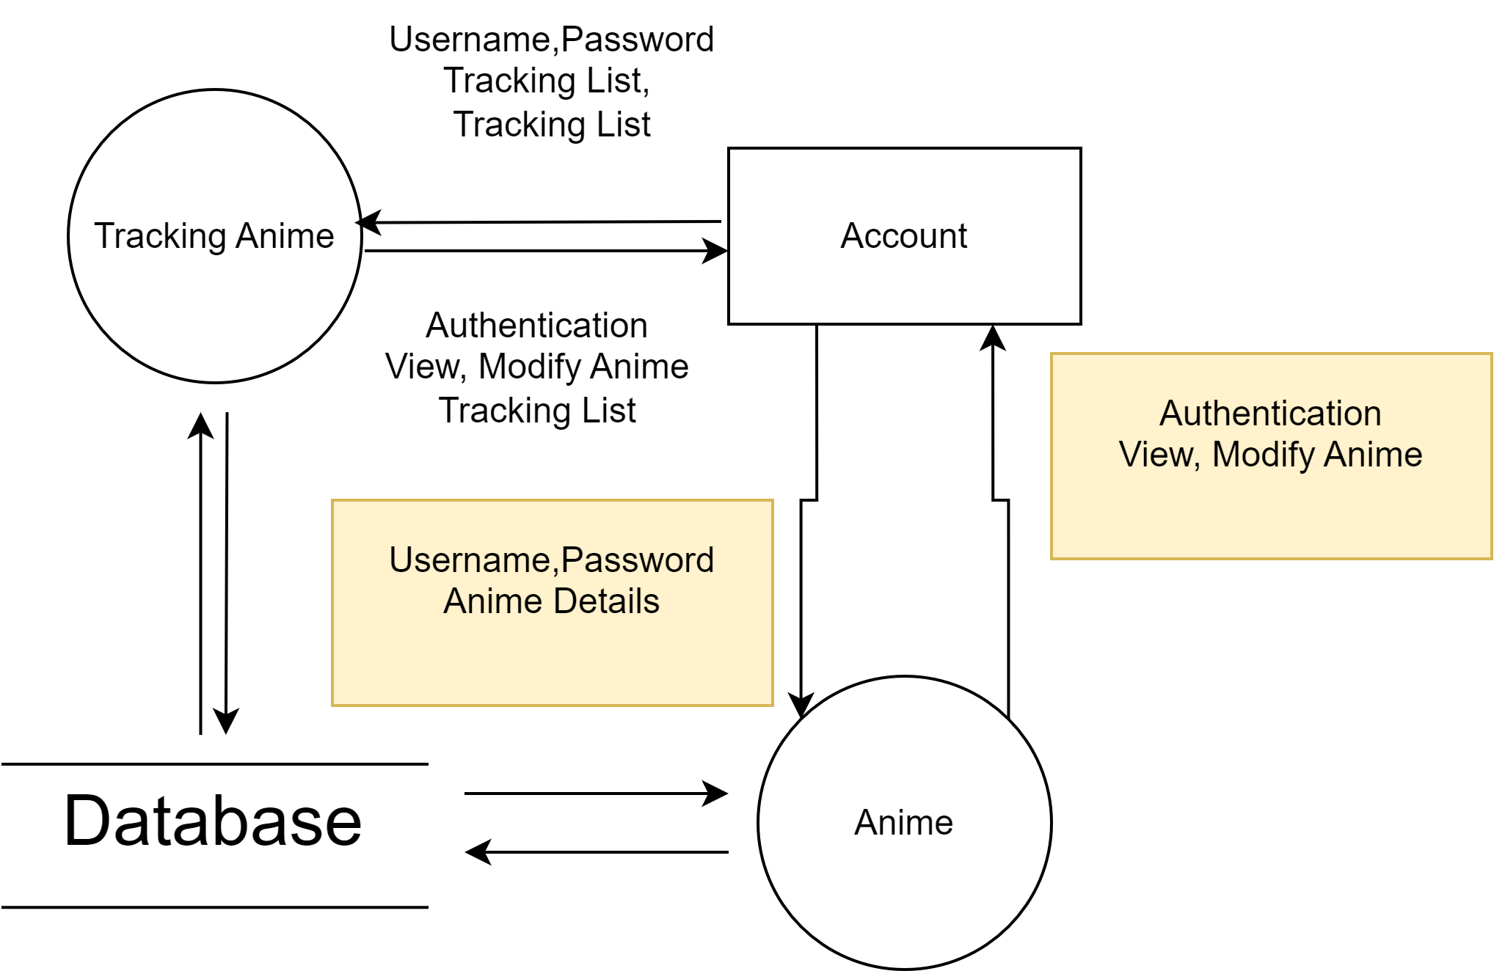
Introduction - Deployment diagram

Slide 7
Test Result [1-n]
1. Customer Profile Management OK
2. Staff and Admin Management OK
3. Connection and Order Management OK
4. Product and Equipment Management OK
5. Invoice and Payment Management OK
6. Search and Query OK
7. Discount and Promotion Management OK
8. Service Tax Calculation OK
9. Login Interface and Access Rights OK
10. Invoice and Payment Details Management OK
11. Information Security OK

Slide 8
Test Result [2-n]
Sr.No | Features Tested | Remarks
1 | Test case | Pass
2 | Test plan | Pass
3 | Test scenario | Pass
4 | Test report | Pass
5 | Requirements Specification | Pass
6 | Functional Specification | Pass
7 | Use-Case Reports | Pass
8 | Project Plan | Pass
9 | Design Specifications | Pass
10 | Prototype | Pass
11 | User’s Manuals | Pass
12 | Business Functions and Rules | Pass
13 | Project or Business Risk Assessment | Pass
14 | Responsibilities | Pass
15 | Approvals | Pass

Slide 9
Conclusion
Tracking Anime is a system would maintain a comprehensive database of anime series, including their titles, genres, release dates, and synopses.
Users would create profiles within the system, allowing them to customize their preferences and track their interactions with different anime series.
Users could browse through the database to find anime series they're interested in. For each series, they could view a synopsis to get an overview of the plot, characters, and themes.
Users could mark whether they've read the synopsis of a particular anime series or not. This feature would help them keep track of which series they've explored and which ones they still need to review.
The system could use algorithms to analyze users' viewing preferences and provide personalized recommendations for anime series with synopses that match their interests.
Users could engage with other members of the community to discuss synopses, share recommendations, and exchange insights about different anime series.
The system could send notifications to users about newly added synopses, upcoming anime releases, or relevant community discussions.

Slide 10
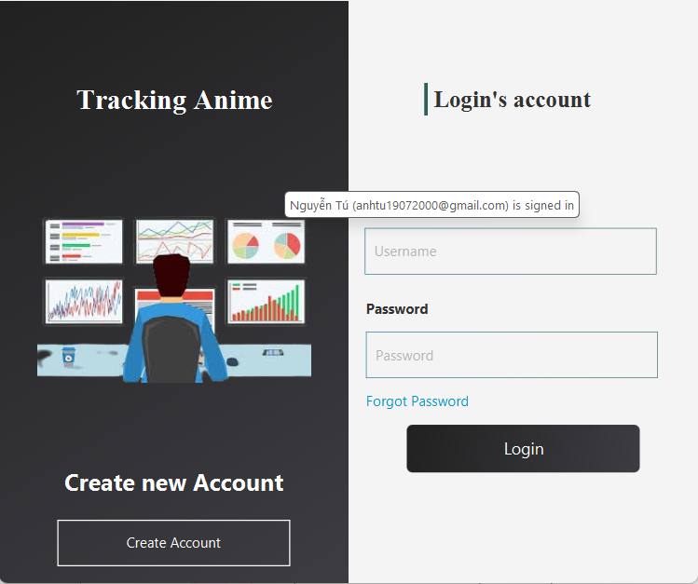
Development
Building by JavaFX

Slide 11
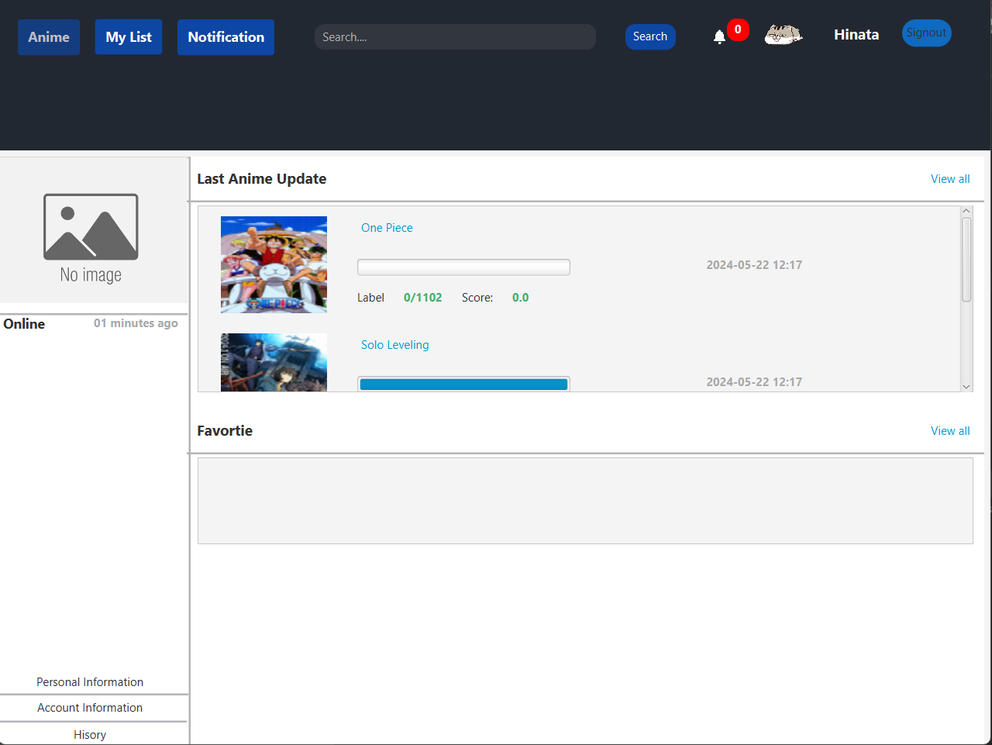
Development

Slide 12
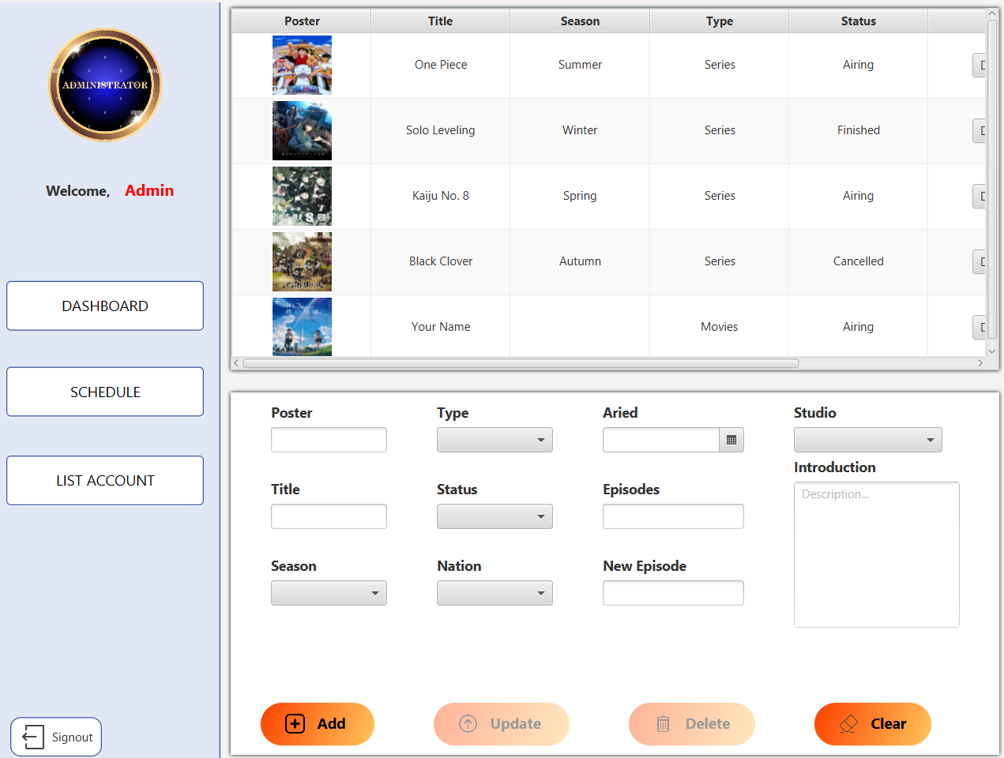
Development

Slide 13
Task List
No | Member | Contents |  | Table Name
1 | Nguyễn Hoàng Anh Tú | Admin | Anime management Account management | Account, Tracking Anime,Anime, Tracking List
2
3 |  | User | Edit profile
4 |  |  | Add tracking anime
1 | Lê Vinh Chí | Admin | Check notification Notification management Set Schedule | Tracking Anime, Notification , Schedule
2
3
4 |  | User | Check notification
1 | Lê Trương Tín | Admin |  | Anime , Tracking List
2
3 |  | User | Add and modify tracking list
4 |  |  | Search anime
1 | Nguyễn Trần Hoàng Long | Admin | Edit Anime | Anime, Tracking List, Feedback
2
3 |  | User | Modify Anime
4 |  |  | Manage Comment

Slide 14

Thank You

Slide 15
Reference
Aptech course

